Slide 1
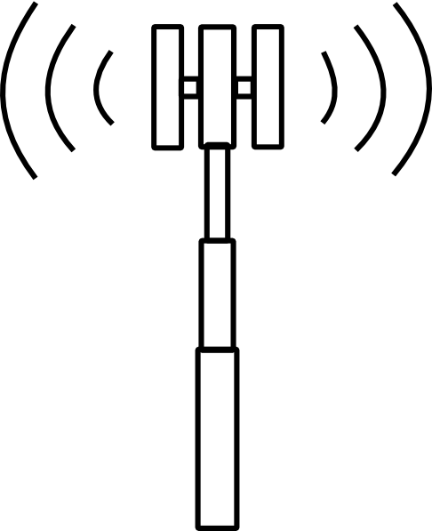
Reapproaching Property Rights and Wireless License Values
Connor Boone
Harrison McNutty
Rushma K
Idea adopted from:
Hazlett, T. (2008). Property Rights and Wireless License Values. The Journal of Law & Economics, 51 (3), 563-598.

Slide 2
Contents of Report
Background
Explanation of Variables
Data Reporting
Explanations and Results
Works Cited

Slide 3

Background
!
BANDS
Governance

Slide 4
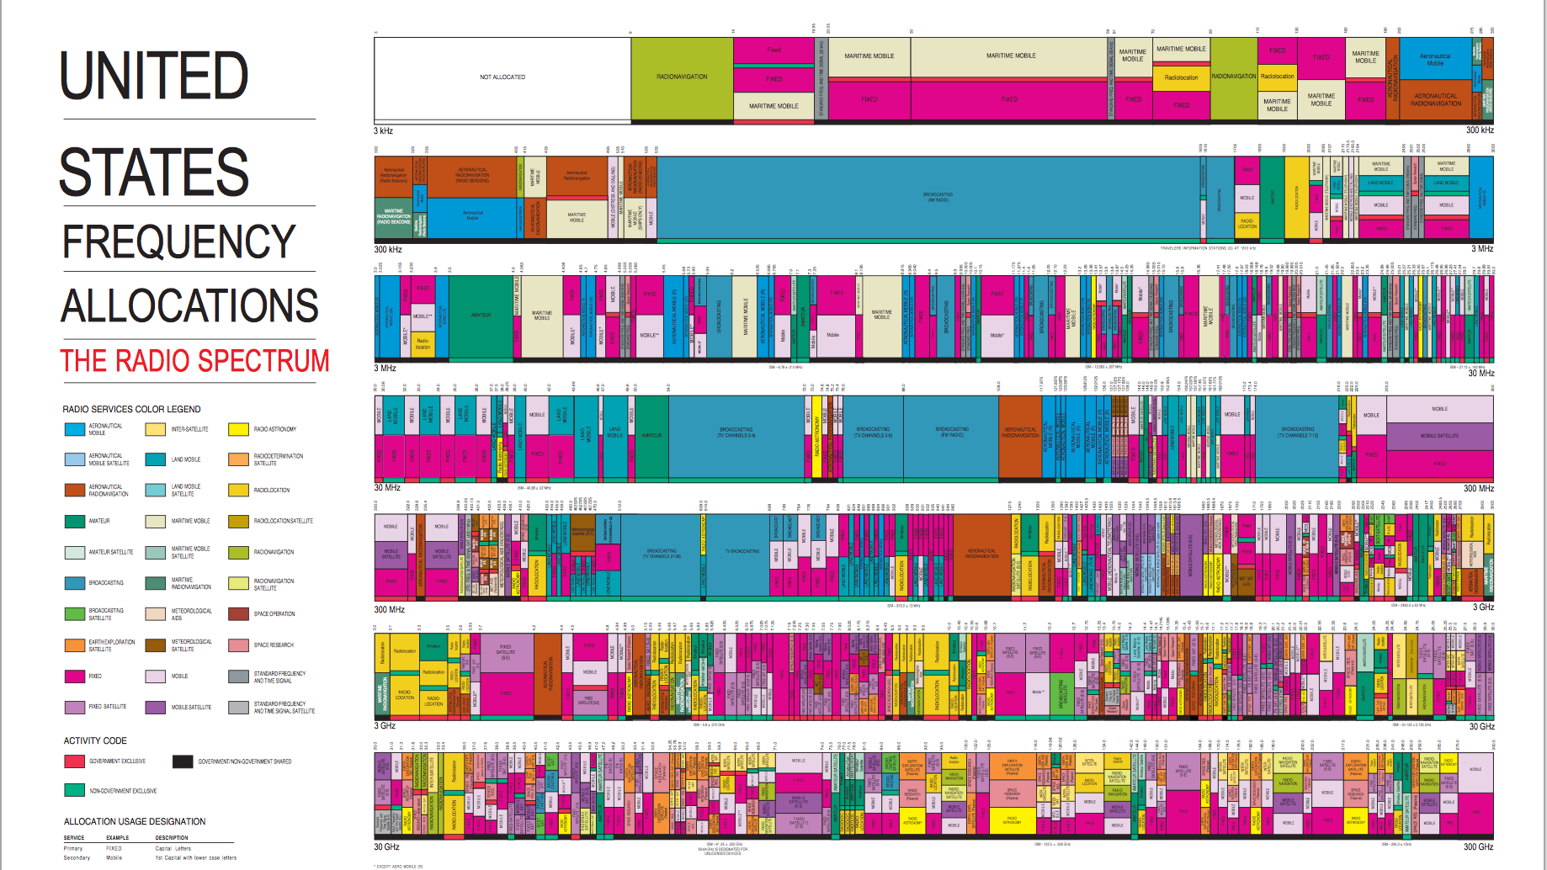
AUCTION 73

